Slide 1



Presented By:
Nicole Colón Carrión
MAXIMIXING YOUR
LINKEDIN PROFILE
February 2024

Slide 2

Table Of Content
Content List
01.
03.
What is LinkedIN
Growing you Network
02.
04.
Profile Basics
Establishing a Presence

Slide 3
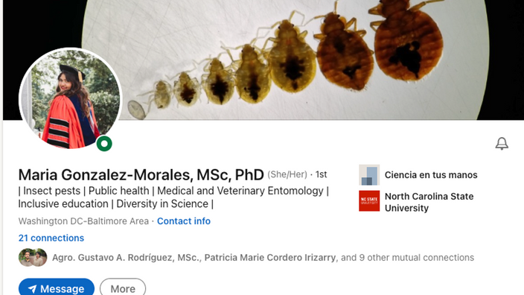

Creating a "mark" around your name or career
01
Professional
Brand
Your professional brand is your story
02
How you distinguish yourself as a candidate
03
04

Slide 4

Over 500 million members and 200 countries
01
Why LinkedIN?
Allows you to create an online professional brand
02
Used by 93% of recruiters to recruit candidates
03
04

Slide 5


Profile Basics

Slide 6

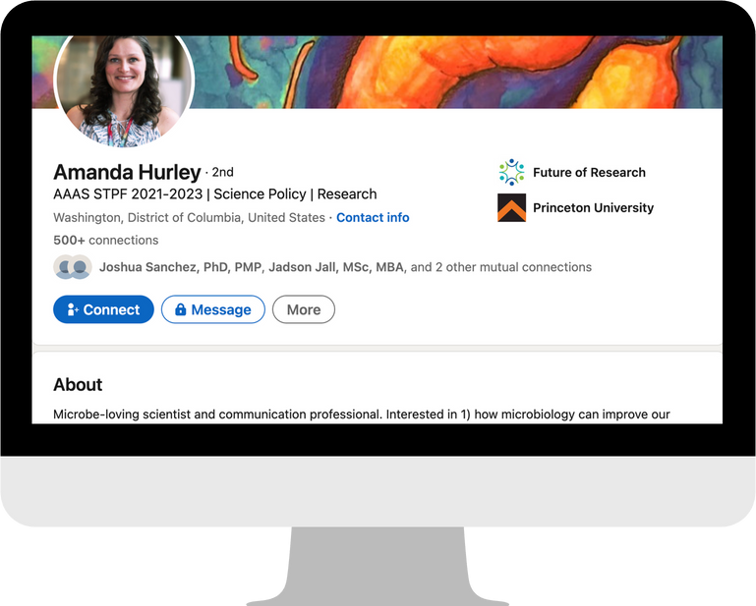




Profile Basics

Slide 7
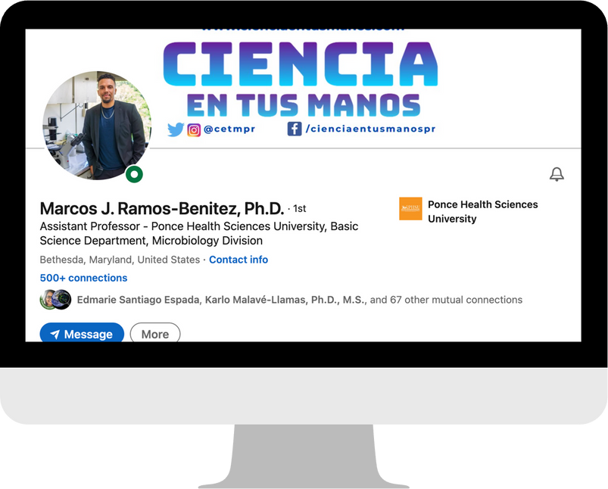

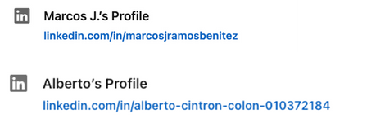
Profile Picture & Customized URL
01
Picture that is up to date
02
Good background
03
Headshot image
04
Professional attire
"Your profile picture is a key element of your LinkedIn presence" - Mic Adam, LinkedIn Trainer

Slide 8
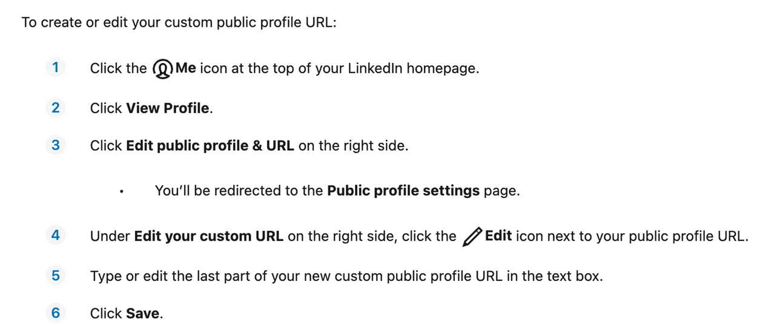
Customized URL

Slide 9
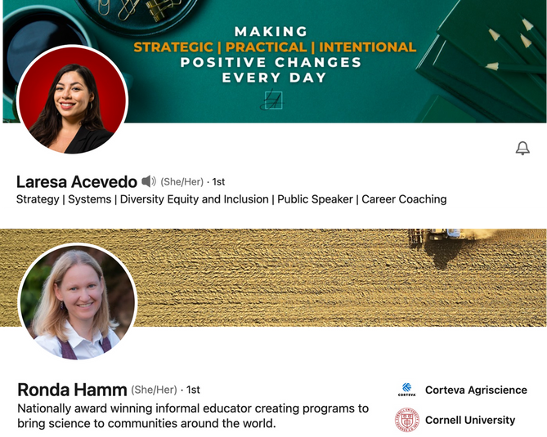
Headline
01
What do you do or aspire to?
02
Who do you serve?
03
How do you do it?
"The most important concept to remember when writing your LinkedIn headline is to keep it keyword relevant" - Noelle Gross, Job Search Strategist

Slide 10
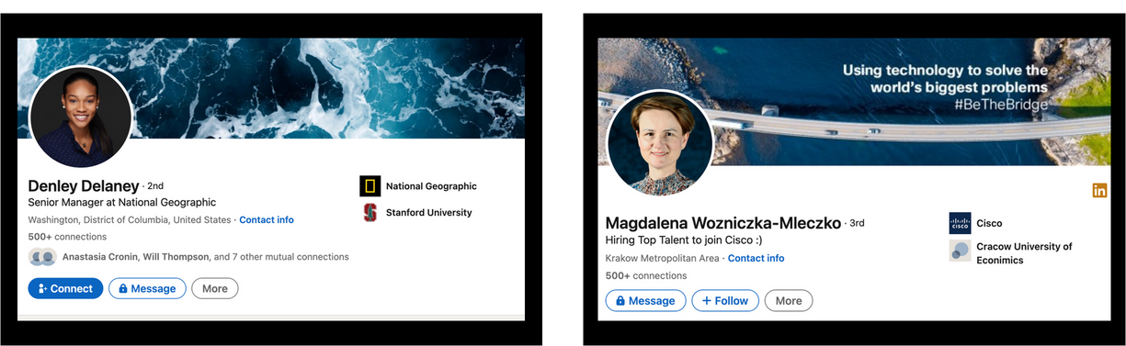
Background Image
"Your LinkedIn cover photo can help new connections and hiring managers get a sense of your personal brand and get to know you a little bit better" - Hallie Crawford, Career Coach

Slide 11
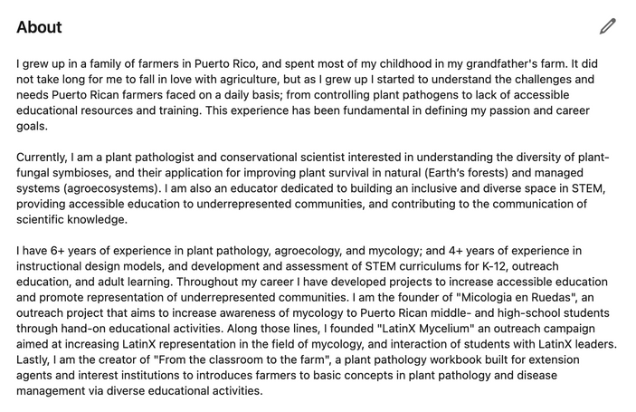
Summary
01
Share what motivates you
02
Talk about your current role
03
Highlights skills and talents
04
Detail accomplishments
"When done well (Your profile), it can grab people’s attention and get them excited about knowing you, learning from you, or working with you" - Coursera Team

Slide 12
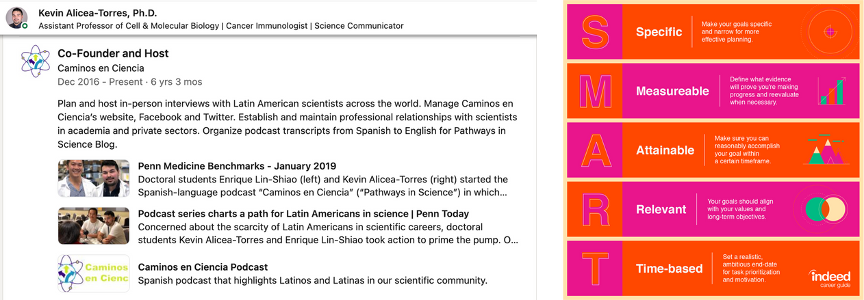
Experiences

Slide 13
Growing your Network

Slide 14
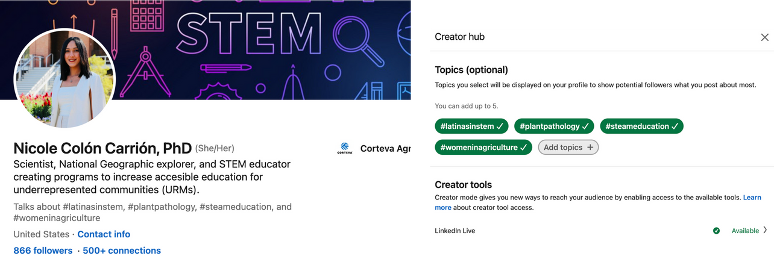
Creator Mode
"If you are looking to grow an audience and cultivate a following to establish your personal brand and services through your content— creator mode is a good option for you" - Salina Yeung, LinkedIn Business

Slide 15
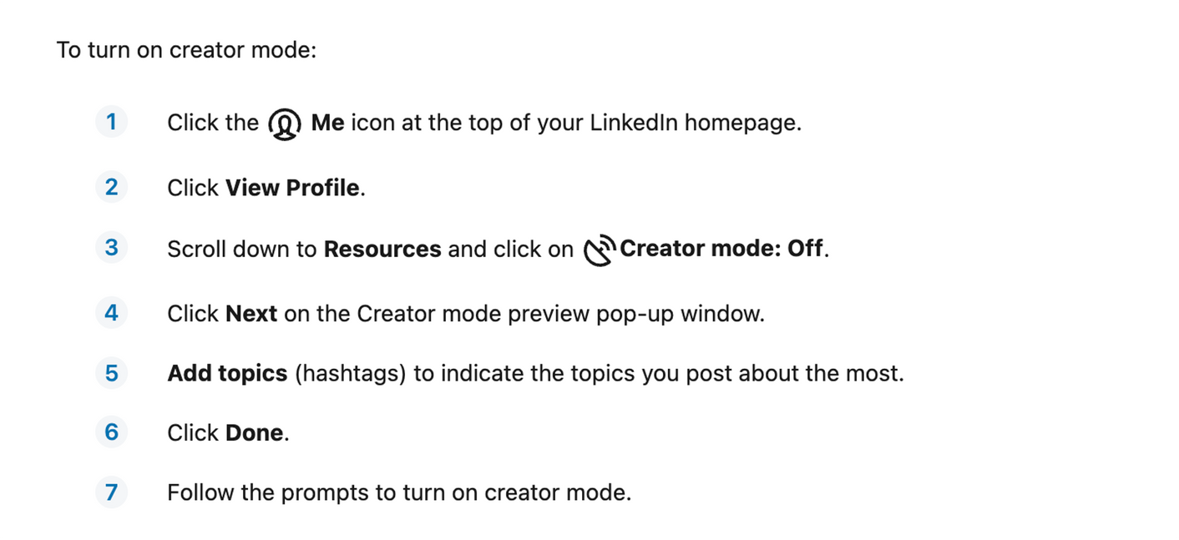
Creator Mode

Slide 16
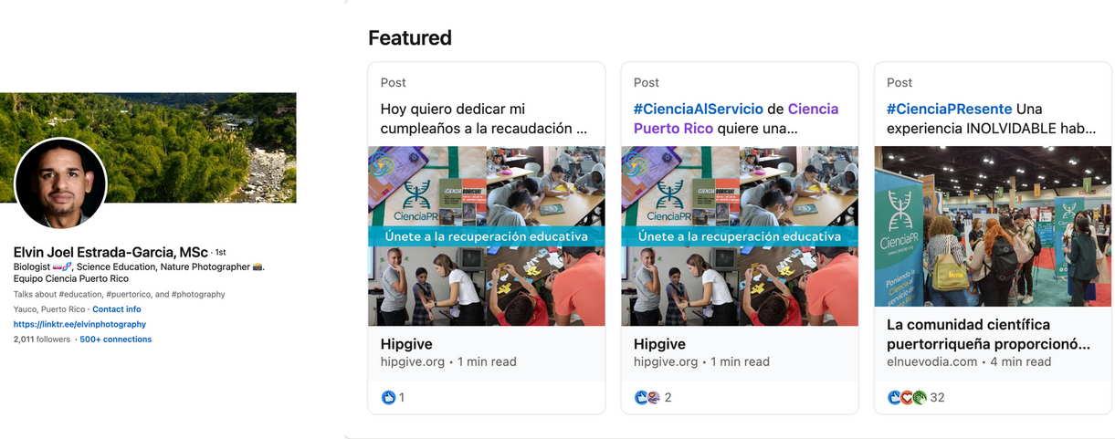
Features
"Showcasing the right content can set you apart from other candidates and leave a strong impression in a decision-maker's mind" - Valerie Morris, Social Media Strategist & Trainer

Slide 17
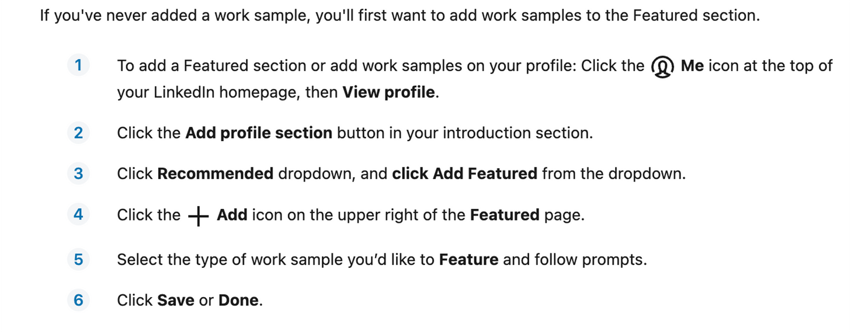
Features

Slide 18
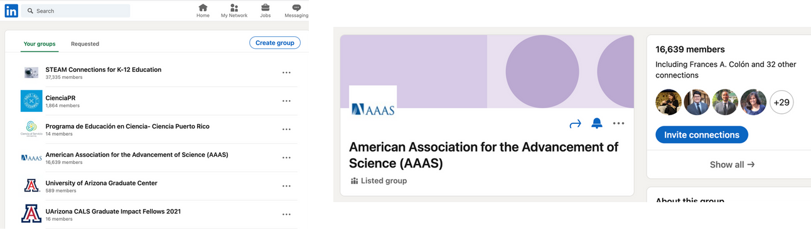
LinkedIN Groups
"Participating in Groups allows you to show off your expertise around a subject and start to grow relationships with like-minded people." - Kristen Curtiss, Social Media Specialist

Slide 19
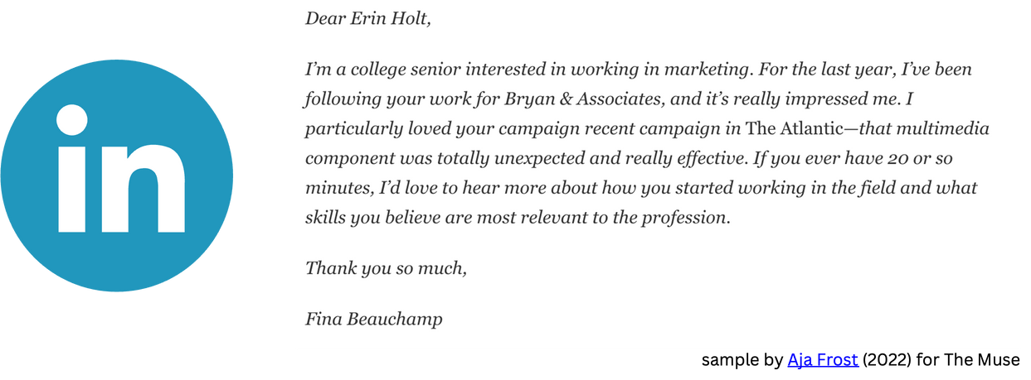
Connection Request
"Those 300 characters can have a big impact" - Aja Frost, HubSpot's Head of Content

Slide 20
Establishing a
Presence

Slide 21
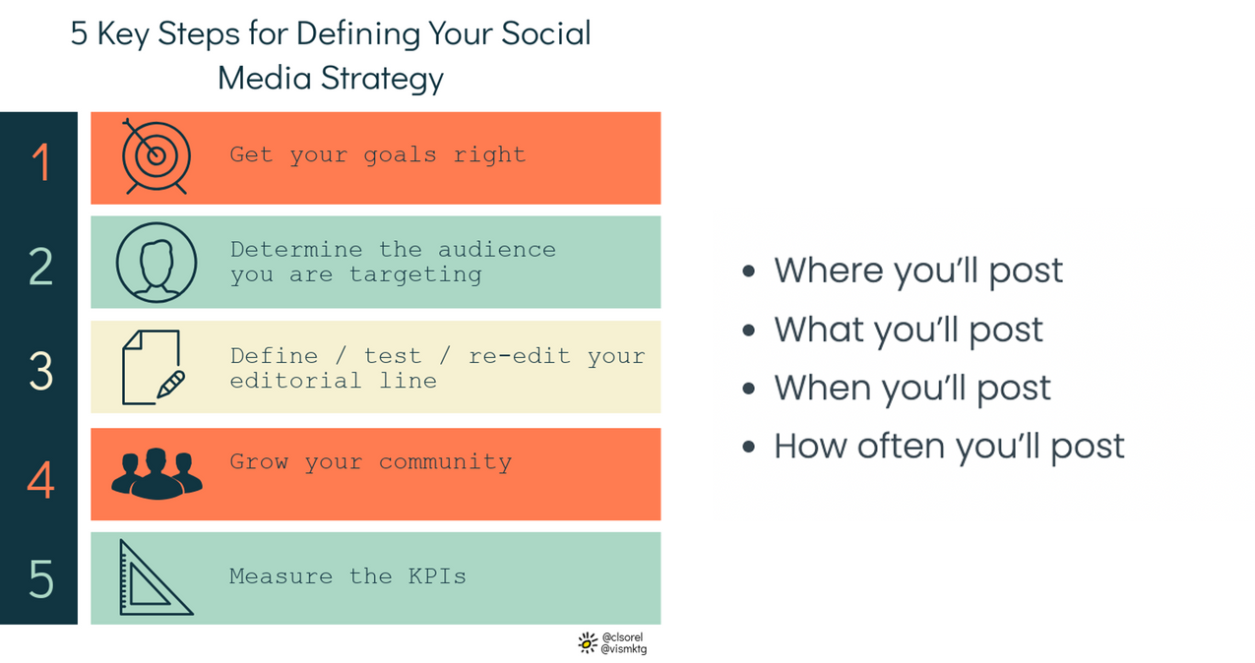
Define a Stategy

Slide 22


Slide 23
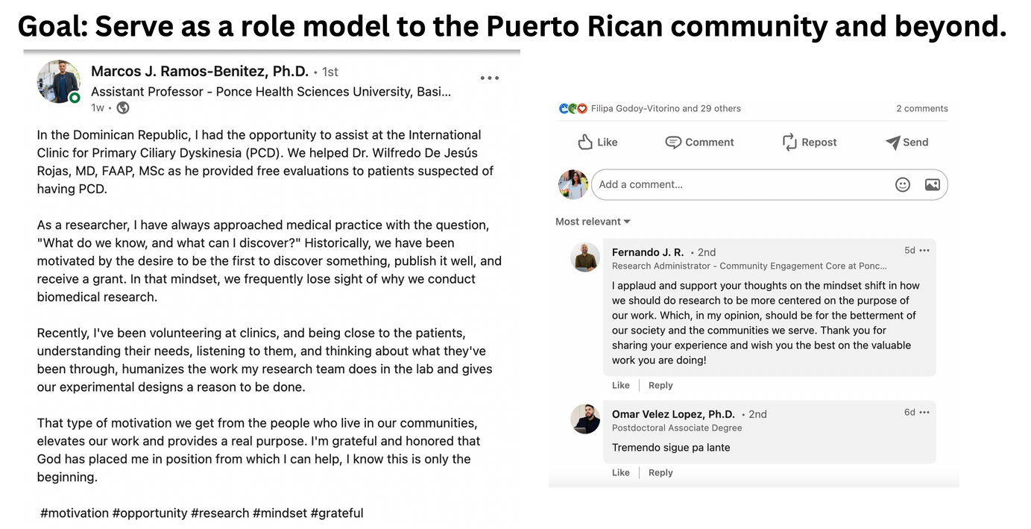

Slide 24
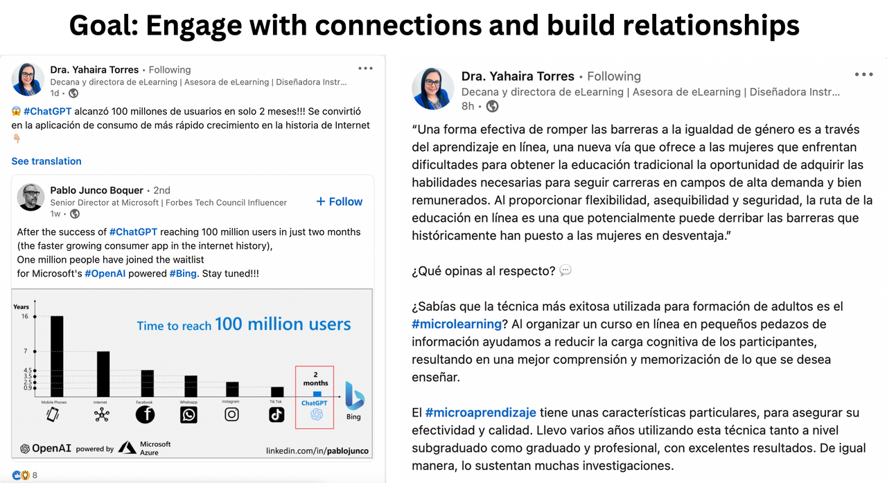

Slide 25
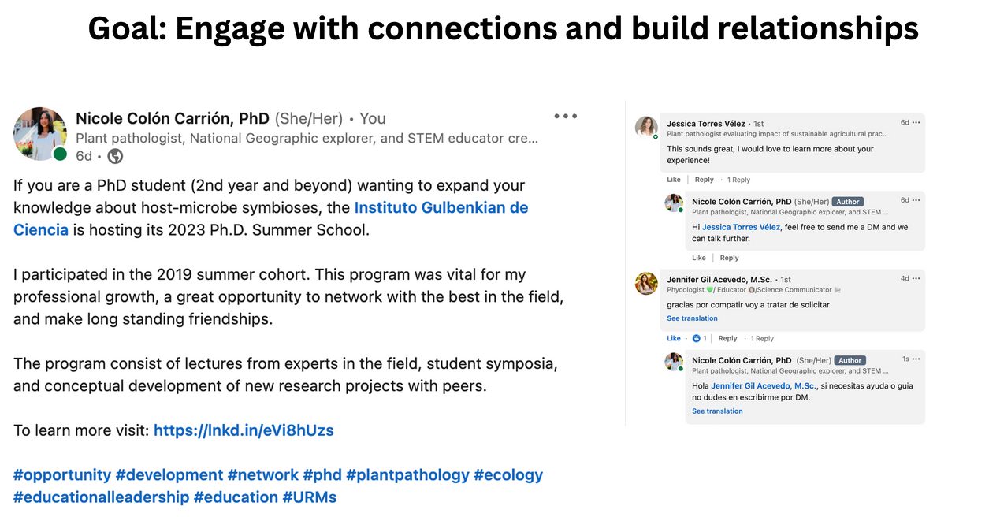

Slide 26
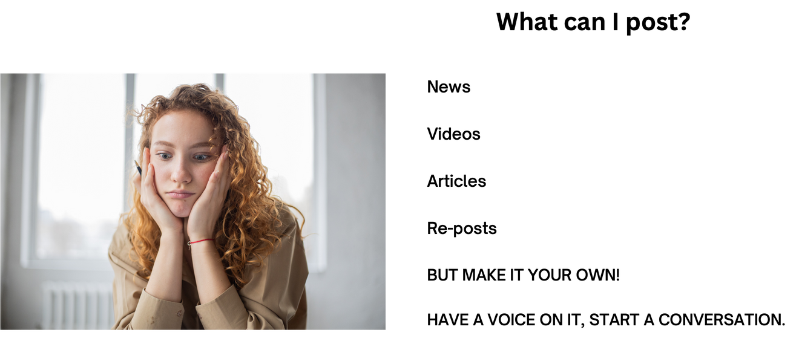

Slide 27
Presented By:
Nicole Colón Carrión
MAXIMIXING YOUR
LINKEDIN PROFILE
February 2024

